Slide 1
Conservative Partnership Institute
Election Integrity Network
www.whoscounting.us

Slide 2
Remember the Original Rainbow Coalition?

Slide 3
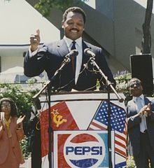
Jesse Jackson in the 1980’s….
Goal was to mobilize millions of Democratic leaning people of color to
Defeat Ronald Reagan…
Create Permanent leftist control over the Democratic Party….
And America
This Photo by Unknown Author is licensed under CC BY-SA

Slide 4
The New American Majority…
Center for Voter Information and Voter Participation Center
Young people,
People of color
Unmarried women
150 million people …
64% of the people who can vote in America

Slide 5
The New American Majority…
Center for Voter Information and the
Voter Participation Center
“Expand Access to Democracy by Underrepresented Populations”

Slide 6
The New American Majority…
Center for Voter Information and Voter Participation Center
Brings “democracy to your doorstep…”
The New American Majority Utilized Mail-Based Voter Resources to Help Decide Election
4.6 million unique vote-by-mail ballot applications in key states.

Slide 7
The New American Majority…
Center for Voter Information and Voter Participation Center –
2.1 Million applications for absentee ballots in Virginia in 2021
Racial minorities
Young people
Unmarried women

Slide 8
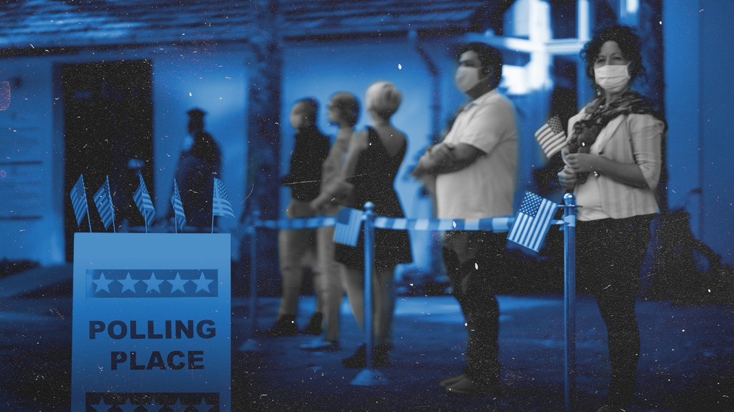
Executive Action to Advance Democracy:
What the Biden-Harris Administration and the Agencies Can Do to Build a More Inclusive Democracy

Slide 9
Demos & ACLU
How Federal Agencies Can Serve their Stakeholders through
Voter Registration Services

Slide 10
Eligible Americans Unregistered to Vote Census Bureau, November 2018
76 million
Each day, federal agencies and their partners provide programs and services to millions of Americans.
Many of these Americans are not registered to vote.

Slide 11
76 million
Low-income Americans and Americans of LLow income Americans and Americans of color are less likely to be registered to vote than higher-income Americans and white Americansow-income Americans and Americans of color are less likely to be registered to vote than higher-income Americans and white Americans.
than higher-income Americans and white Americans.
less likely to be registered to vote than higher-income Americans and white Americans.

Slide 12
Effective federal agency registration can help millions of additional eligible Americans become registered to vote and reduce income- and race-based registration disparities to ensure that all eligible Americans are able to participate in the democratic process.

Slide 13
Federal agency voter registration can be particularly impactful in programs that provide services, beneﬁts, and public assistance.

Slide 14
Potential Impact of Federal Agency Voter Registration
2.6M American Indians & Alaska Natives served by federally & tribally-run Indian Health Service facilities
17.7M Students submitting FAFSA forms
3M mostly low-income Americans served by the Volunteer Income Tax Assistance (VITA) program
64M elderly and disabled Americans served by the Social Security Administration
800k+ new citizens at USCIS naturalization ceremonies
4M+ low-income Americans receiving rental assistance through HUD programs

Slide 15
How to Provide Effective Voter Registration Through Federal Agencies

Slide 16
Elements of Successful Agency Registration
Incorporate Eﬀective and Accessible Voter Registration Services into all Relevant Agency Transactions
Establish a System for Collecting and Transmitting Completed Voter Registration Forms
Appoint a Voter Registration Coordinator
Provide Robust, Regular Training for Staﬀ
Collect and Report Data on Agency Registrations
Obtain Guidance from State and Local Election Oﬃcials and Community Groups
Provide Accessible Voter Education Materials

Slide 17
Present the Opportunity as Part of an Existing Transaction
Ensure all voter registration services are available for transactions conducted in-person, online, by mail, by telephone, or by any other means.
Ask the applicant, in writing, if they want to register to vote or update their voter registration.
Inform applicant in writing of their rights to register, to privacy while registering, and to choose a political party.
Provide a voter registration application to clients who want to register to vote.
Provide assistance in completing the voter registration form.
Provide voter registration materials in all the languages available for your own services, and in a manner accessible to clients with disabilities.

Slide 18
Provide Accessible Voter Education Materials
Information on how to vote and where to ﬁnd one’s voting location
Palm cards with election dates and voting options
Information on election protection hotlines
Information about the process for voting in that state
Voter education materials in all the languages available for your own services, and in a manner accessible to clients with disabilities.

Slide 19
Contact Us
for more materials, and to talk about whether and how voter registration can be integrated at your agency
Demos:
Brenda Wright bwright@demos.org Laura Williamson lwilliamson@demos.org
Shruti Banerjee sbanerjee@demos.org
ACLU:
Sarah Brannon sbrannon@aclu.org Ceridwen Cherry ccherry@aclu.org Kristen Lee klee@aclu.org

Slide 20
When done well, providing voter registration through federal agencies will be a convenient and effective way to serve the public and potentially add millions of eligible, previously unregistered voters to our voting rolls, helping to reduce voter participation disparities by race and income.

Slide 21
Why Does This Matter?
What Does This Mean for 2022
…and beyond?

Slide 22
March 7, 2021: Biden Executive Order 14019 Voting Access EO
Federal Agencies to Develop Voter Registration Plans by September 2021
Submit to White House….Susan Rice
Grants to “approved groups” to “get out the vote” in 2022 elections
BIDEN BUXX….

Slide 23
March 7, 2022: Demos Updates the Nation on the Biden Order
Bloody Sunday, March 7 1965
Voting Access
Executive Order
“We must not underestimate the progress and yet-untapped potential of this executive order”

Slide 24
What Federal Agencies Are Doing So Far….
Indian Health Services: voter registration services and assistance to its patients
Department of the Interior share registration and voting information with Native students:
Tribal Colleges and Universities designated as NVRA voter registration agencies.
Department of Health and Human Services will provide access to and assistance with voter registration to the millions of users of HealthCare.gov

Slide 25
What Federal Agencies Are Doing So Far….
Exhibit C
ARIZONA
Arizona’s Health-e-Arizona Plus online application portal, showing that communication about voter registration is offered through email, text, or whichever way individuals have selected to communicate with the agency

Slide 26
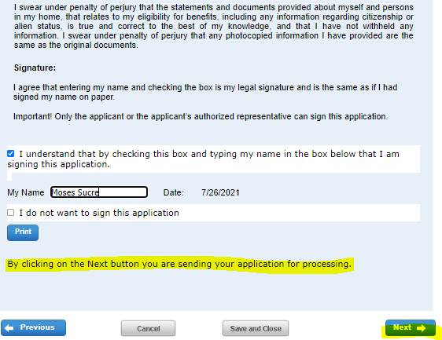
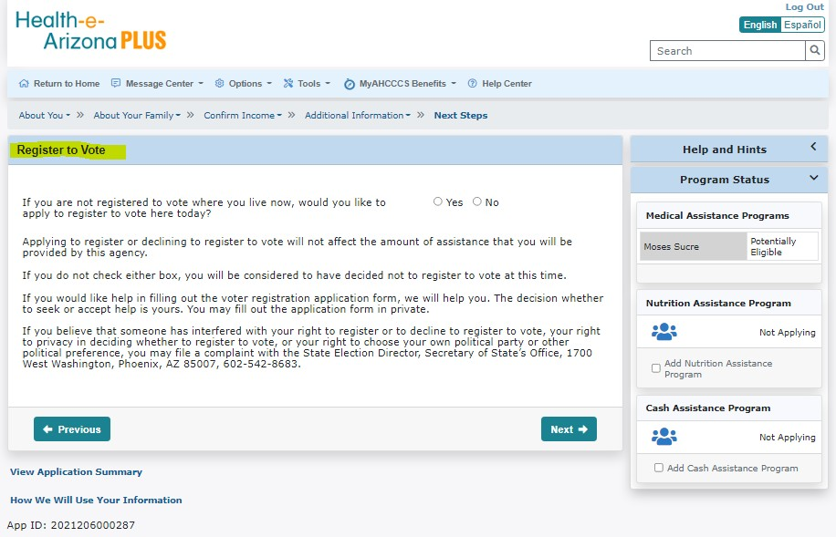
3.8$ Customer Profile$ 2021206000287$ Voter Registration page
After Submitting the application, the customer will be navigated to the Voter Registration Page

Slide 27
Health-e­
Arizona PLUS
Q Return to Home €) MessageCenter • ® Options •
Search
Tools • 0 MyAHCCCS Bene.fits • (!) Help Cente-r
Voter Registration Format Preference
Help and Hints
<
You said you want to register to vote, or you did not answer the voter registration question. To change your response to the voter registration question, go back.
The answers on this page are ONLY for purposes of voter registration. The choice you make on this page will NOT change how you willget other letters from HEAplus.
How would you like to get the voter registration form?
0 Online using Service Arizona
0 The same way I get my other letters from HEAplus
0 By US Mail
Cl.i.c.k..h_el'..eJo..r..mo.r.ej.ttfo..r.ma_ti_Qn_a_b_o_u_t r.egis_t_e_lio_g too_te_
Program Status
Medical Assistance Programs
Moses Sucre
Potentially Eligible
Nutrition Assistance Program
•..•...•.
Not Applying
To register to vote in Arizona, you must be a U.S. citizen (proof of citizenship required to vote a "full ballot''), To be eligible to vote a "full ballot," you must submit proof of citizenship with your registration form or by 5:00 p,m, on the Thursday before Election Oay. A "full ballot" includes all federal, state, county, and local races and ballot propositions/referenda for which you are eligible to vote.
0 Add Nutrition Assistance
Program
Cash Assistance Program
Fl@ii
•..•...•.
Not Applying
iitliiiHF
0 Add Cash Assistance Program
View Application Summary
HowWeWill Use Your Information
App ID:2021206000287

Slide 28
CTCL Contract Requirement in Wisconsin
Recommendation I: Encourage and Increase Absentee Voting (By Mail and Early, In-Person)
Recommendation II: Dramatically Expand Strategic Voter Education & Outreach Efforts, Particularly to Historically Disenfranchised Residents
Recommendation Ill: Launch Poll Worker Training
Recommendation IV: Ensure Safe & Efficient Election Day
As detailed in this plan, our municipalities are requesting a total of $6,324,567

Slide 29
RACINE COUNTY
SHERIFF'S OFFICE
ELECTION
INTEGRITY
Protecting Vulnerable Voters

Slide 31
What we can do…
Form Local Task Forces!
Reporting Systems To Track Abuse of Vulnerable Voters
Who’s Getting $$ And Monitor What Are They Doing
Outreach To Targeted Populations Re: Protecting Their Votes
Protect Vulnerable Voters in Every County

Slide 32
Join the Election Integrity Network
Conservative Partnership Institute’s
Election Integrity Network www.whoscounting.us cmitchell@cpi.org

