Slide 1
Message Discipline: The Key to Grassroots Engagement Success

Slide 2
Message Discipline Fundamentals
Message discipline problems are not content problems
Message discipline problems are message problems
Message discipline problems are discipline problems

Slide 3
Two Kinds of Message Discipline
The kind where you get your point across
The kind where you keep your team on the same page

Slide 4
Getting Your Point Across
1. Prioritize your goals
2. Craft a messaging document
3. Craft a talking points document
4. Use plain language

Slide 5
Staying on the Same Page
1. Teach people what NOT to say
2. “Individuality is fine as long as we all do it together.”
3. Room for personality and adjusting to an audience but always in the context of the message

Slide 6
The Secret Sauce of Successful Message Discipline
L.E.A.D.E.R.S.H.I.P.
It’s not hard
It’s not exciting
It is absolutely necessary

Slide 7
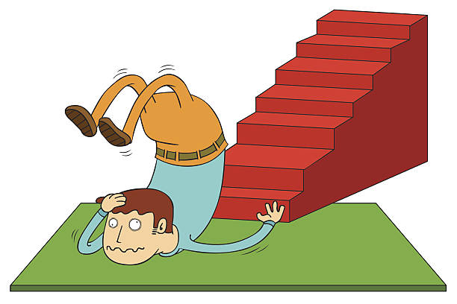
Rule # 1

Slide 8
Kerri Toloczko State Networks Director Election Integrity Network KToloczko@CPI.org

